Slide 1
44th World Continuous Auditing and Reporting Symposium
“Accounting and Auditing in an Artificial Intelligence Environment”
Foro Fundación Cajasol · Sevilla, Spain
March 21 & 22, 2019
Accounting and auditing in an artificial intelligence environment: insights from the academic literature
Rita Lamboglia, University of Naples Parthenope
Domenica Lavorato, University of Naples Parthenope
Eusebio Scornavacca, University of Baltimore
Stefano Za, LUISS University

Slide 2
Research Agenda
Motivations
Research question
Data collection and refinements of results
Descriptive findings
Bibliometric analysis
Conclusions and future developments

Slide 3
Motivations
Over the last three decades, the emergence of disruptive digital technologies had led significant structural changes across a number of industries;
The field of auditing is being disrupted by the recent developments in technologies based on Artificial Intelligence and have the potential to tremendously benefit from their applications;
Digital technologies and Artificial Intelligence are gradually replacing traditional audit trails thereby completely changing the entire audit process;
Despite the relevant effects of Artificial Intelligence in auditing, these issues seem to be under researched.

Slide 4
Research question
What is the the current state of the literature on the use and application of artificial intelligence in auditing?

Slide 5
Research methodology
1
2
Descriptive analysis
3
Bibliometric analysis
Data collection and refinements of results

Slide 6
Data collection and refinements of results
Articles identified through WoS (n=3952)
Article search/ search string:
(technolog* OR "information technolog*" OR "information system*" OR "artificial intelligence") AND (audit*)
Articles identified through Scopus (n=18,102)
Articles identified through WoS (n= 3,952)
Articles identified through Scopus (n= 18,102)
Excluding articles by document type on WoS
(n= 3,486)
Excluding articles by document type on Scopus
(n= 9,445)
Excluding articles by year on WoS (n= 3,431)
Excluding articles by year on Scopus (n= 9,334)
Excluding articles by accounting ABS ranking on WoS (n= 116)
Final sample after deleting duplicate (n=214)
Excluding articles by accounting ABS ranking on Scopus (n= 172)

Slide 7
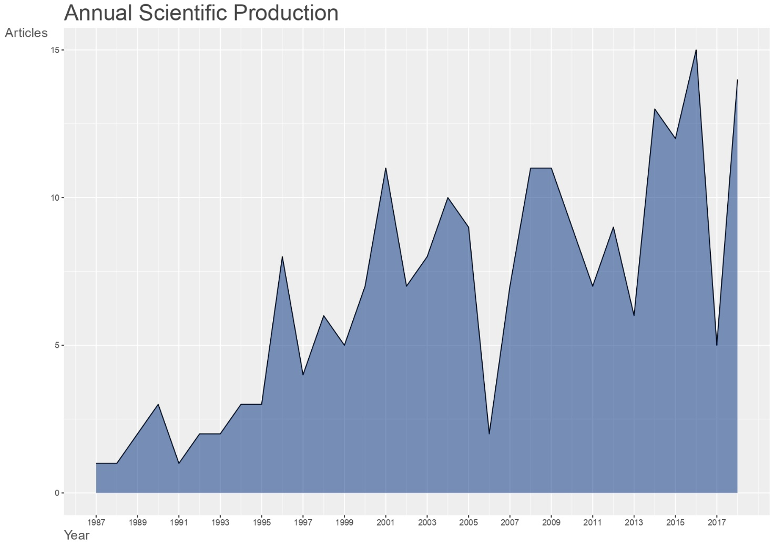
Descriptive findings

Slide 8
Descriptive findings
- Journal’s distribution
Journals | Ranking ABS | Number of articles
ACCOUNTING REVIEW | 4* | 8
ACCOUNTING ORGANIZATIONS AND SOCIETY | 4* | 19
CONTEMPORARY ACCOUNTING RESEARCH | 3 | 7
ACCOUNTING HORIZONS | 3 | 14
AUDITING-A JOURNAL OF PRACTICE \& THEORY | 3 | 34
INTERNATIONAL JOURNAL OF ACCOUNTING INFORMATION SYSTEMS | 2 | 65
MANAGERIAL AUDITING JOURNAL | 2 | 67

Slide 9
Bibliometric analysis
Citation analysis: most productive authors, most productive country, top 10 cited articles;
Network analysis: author’s keywords co-occurence.

Slide 10
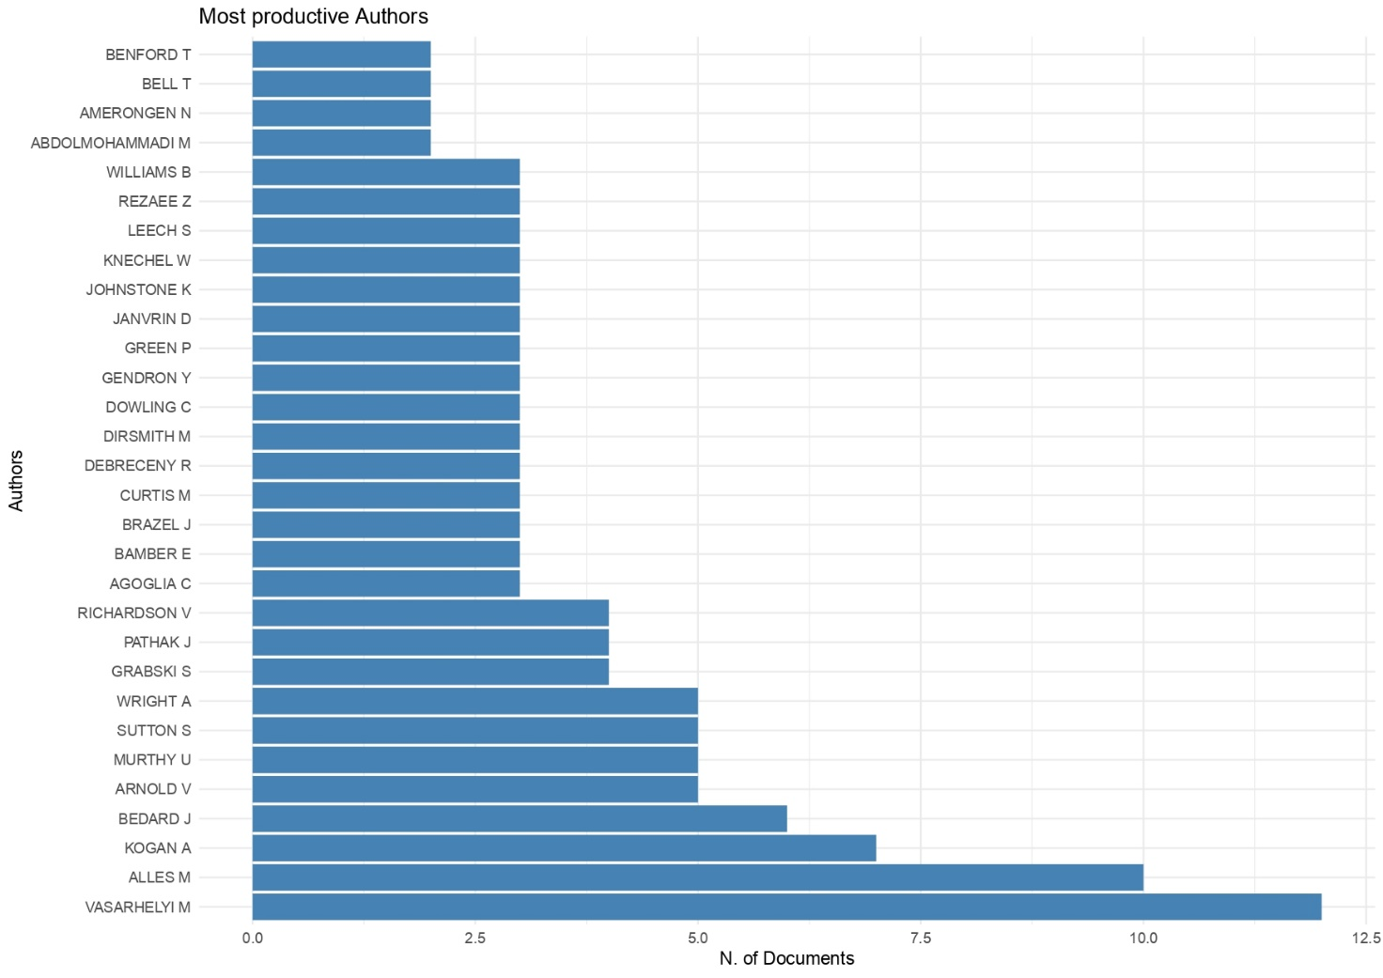
Citation analysis

Slide 11
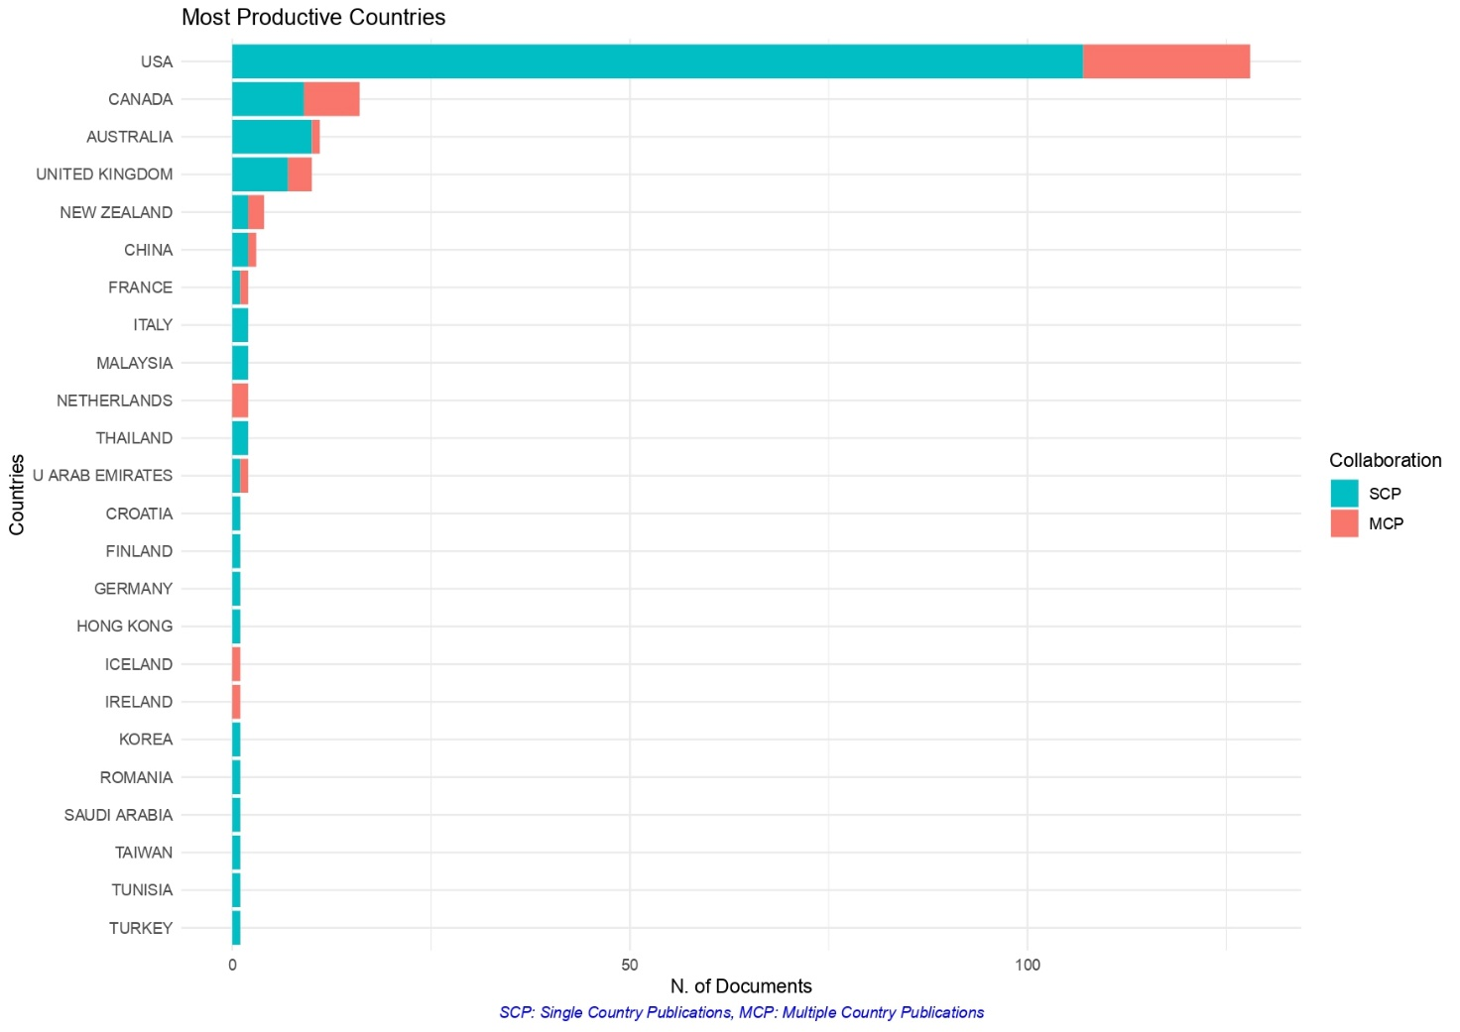
Citation analysis

Slide 12
Citation analysis
- Top 10 cited articles
 | Paper | Total Citation | TCperYear
1 | BEASLEY MS, 2000, ACCOUNT HORIZ | 362 | 19.053
2 | KNIGHTS D, 1987, ACCOUNT ORGAN SOC | 162 | 5.062
3 | BAMBER EM, 1993, AUDIT -J PRACT THEORY | 120 | 4.615
4 | CURTIS MB, 2008, INT J ACCOUNT INF SYST | 108 | 9.818
5 | ARENA M, 2010, ACCOUNT ORGAN SOC | 102 | 11.333
6 | ALLES M, 2006, INT J ACCOUNT INF SYST | 101 | 7.769
7 | BARRETT M, 2005, ACCOUNT ORGAN SOC | 96 | 6.857
8 | DOWLING C, 2007, INT J ACCOUNT INF SYST | 96 | 8.000
9 | GENDRON Y, 2007, ACCOUNT ORGAN SOC | 85 | 7.083
10 | VERA-MUÃ‘OZ SC, 2006, ACCOUNT HORIZ | 82 | 6.308

Slide 13
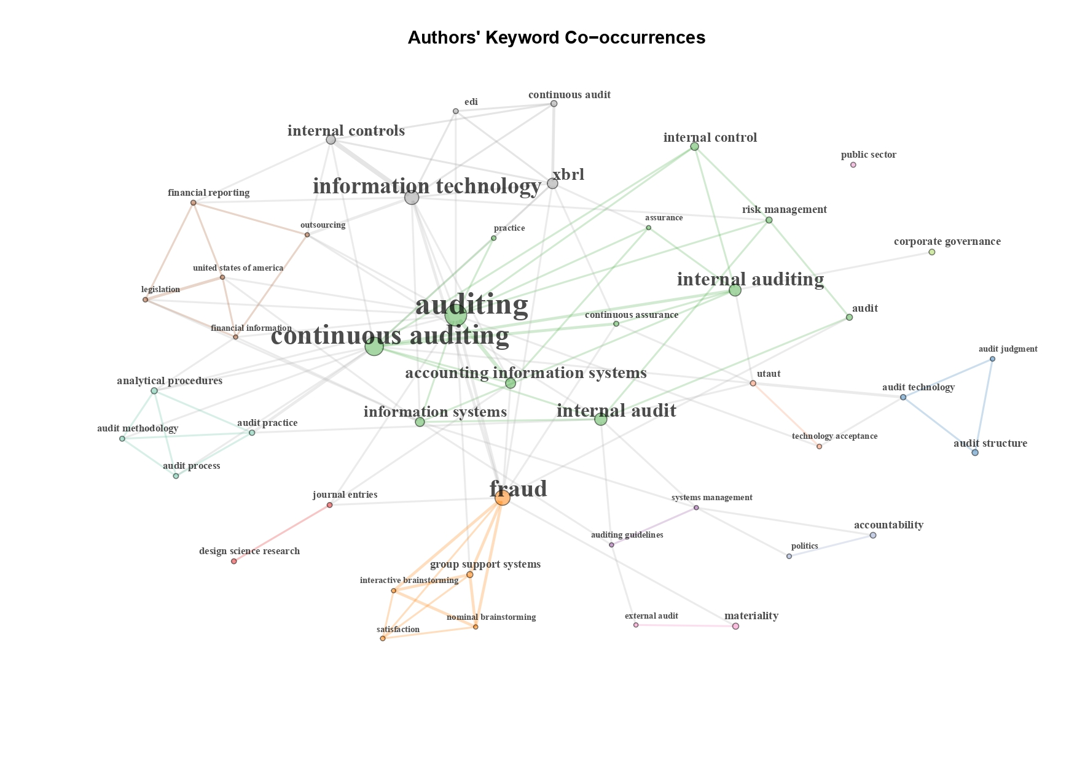
Network analysis

Slide 14
Conclusions and future developments
Main conclusions:
Increasing relevance of the topic in the academic community;
Main topics and lines of research: auditing, technology, fraud and continuous auditing;
The main possible relationships between the different topics are represented by xbrl;
Future developments:
Co-citations analysis;
Systematic literature review.

Slide 15
Thanks for your attention!
Corresponding author
Domenica Lavorato
E-mail: domenica.lavorato@uniparthenope.it

